Slide 1
Assessments & SMART Goals
Parents Helping Parents
Sobrato Center for Nonprofits- San Jose
1400 Parkmoor Ave., Suite 100
(408)727-5775 or (885)727-5775 (toll free)
www.php.com

Slide 2
PARENTS HELPING PARENTS HOW CAN WE HELP?

Slide 3
Training Objectives
Understanding the assessment process
How does the assessment drive a goal
All about SMART Goals
Understand how progress informs the process
Present information and skills to enable effective participation in the goal writing process

Slide 4
What do I need to know about REFERRAL by SCHOOL?
The school may ask to assess your child. The request is made in writing.
You may say Yes or No to the request.

Slide 5
What do I need to know about REFERRAL BY PARENT
Parents may make a written request for assessment
The school district may say
Yes: Written notice Seeking written consent
No: Written notice and rights
Let’s try something else first:
Different teaching method
Accommodations
*Your school may invite you to a meeting around the 15th day after your write.

Slide 6
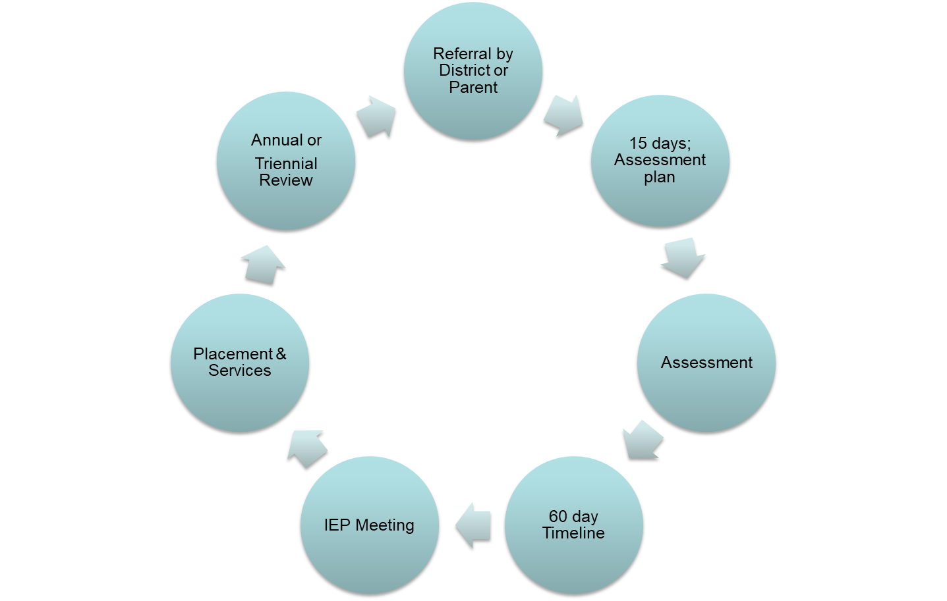
SPECIAL EDUCATION ASSESSMENT CYCLE

Slide 7
What do I need to know about ASSESSMENT?
Why have an assessment?
Determine if your child has a disability and needs special education and related services
To understand your child’s needs and strengths
To make educational decisions

Slide 8
What do I need to know about ASSESSMENT?
Assessments may include:
Tests
Medical reports
Observation
A review of the child’s work
Interviews with teachers
Interviews with parents
Other sources including information from you!

Slide 9
What do I need to know about
ASSESSMENT QUESTIONS?
You may ask questions about assessments, such as:
What assessments will be used?
Are they accurate?
Will they be in my child’s first language?
May I see test results?
*Assessments' may not discriminate against your child (culture, disability, or other)

Slide 10
What do I need to know about ASSESSMENT RESULTS?
Assessment results will show if a child needs special education:
If the assessment does not “fit” what you know about your child:
Say so in writing
Meet to talk about the concerns
Ask for more testing, or
Ask for Independent Educational assessment (IEE) at district expense

Slide 11
What do I need to know about ELIGIBILITY DECISIONS?
A group (parents & professionals) determines eligibility
After reviewing results of assessment report & information.
If you disagree with the decision you can:
Do it in writing
Ask what steps to take
Follow through with the steps!

Slide 12
What do I need to know about ELIGIBILITY AT THE IEP MEETING?
If you agree with the decision:
IEP Team meeting will be held (parents and school staff)
Team reviews assessment
Team writes Individualized Education Program (IEP)
You must be invited to help develop your child’s IEP! The parent is part of the IEP team

Slide 13
Assessments Drive GOALS
Notes:
Assessments Provide a Roadmap
Assessment professionals try to understand how your child thinks, reasons, and processes information. A formal evaluation should give you a clearer understanding of your child. An evaluation should also offer strategies for addressing your child’s needs. A good evaluation creates a road map about what to anticipate as your son or daughter gets older and expectations increase at school and elsewhere.
Assessment or testing are other terms for evaluations. In an assessment, the evaluator works with a student using paper and pencil tasks and other activities to figure out your child’s skill levels in different areas. The evaluator’s observations of a child’s behavior and problem solving style also provide information about individual difficulties and strengths.
The larger goal of the assessment process is to provide a big picture view of your child’s vulnerabilities—and resources. This information helps guide your decisions about education, behavior, and other areas.

Slide 14
What are SMART IEP goals?
Specific:
More specific (better), Less specific (worse)
Measurable:
Can you count or observe it?
Action Words:
Increase, decrease, maintain
Realistic and Relevant:
Address the child’s unique needs
Time-Limited:
Progress can be measured

Slide 15
What happens at the Annual or Triennial IEP meeting?
A review the student’s past progress.
Discuss the student’s present level of education performance when estimating what can be expected in a years time or the duration of the IEP.
Think of the practicality of the chosen goals in terms of final outcomes, age appropriateness, relevancy.
Establish goals in all areas of need

Slide 16
Present Level of Performance
“A statement of the child’s present levels of academic achievement and functional performance”…[and] a statement of measurable annual goals, including academic and functional goals, designed to meet the child’s needs that result from the child’s disability to enable the child to be involved in and make progress in the general education curriculum; and…meet each of the child’s other educational needs that result from the disability.

Slide 17
Goal Areas to Consider
Identify the category of instruction for each deficit area. These may include the following:
Social Skills
Communication
Leisure/Recreations Skills
Vocational Skills
Personal Management
Academics
Perceptual Skills
Behavioral Skills
Physical Skills
Self-Help Skills
Was there assessment in and of these areas?
Goals are based on assessment information

Slide 18
Goal Areas
Pre or Academic: reading, writing, spelling, math
Self-Help: [Functional] eating, dressing, bathing, shopping
Leisure/Recreational: using community resources
Vocational: skills required for employment
Transitional: Further education etc.
Motor: movement, balance, strength and coordination
Social/Behavioral: manners, behaviors and relationships
Communication: Articulation, social communication, social interactions…etc.

Slide 19
Present Levels of Performance (PLOP)
In short, the present levels statement of academic achievement and functional performance describes how your child is doing in school and identifies those areas where he or she is having difficulty.
A clearly written and thorough ‘present levels’ is important, because it is the foundation for all of the IEP.

Slide 20
Essential Goal Contents
WHO? Will achieve
WHAT? Skill or behavior will be affected
HOW? In what manner or at what level
WHERE? In what setting or under what conditions
WHEN? Beginning when, in what increments, ending what date

Slide 21
Example of a goal using Weight Loss
3000 calories/day
Reduce food intake
-500 day = 1lb loss/week
Add exercise
1000 calories/day
2lb loss/week
You decide to loose 50 lbs, since you weigh 190
Reduce calories to 800 cal/day
-20 lbs in 12 weeks!
In twelve weeks you weigh 170!
Now you focus on the long term goal to loose 50 total lbs

Slide 24
Sample Goal
[PLOP]: Present Level of Performance: 1 out of 4 trials
Because of weakness in his hands and dependence on staff, John requires assistance choosing items to play with. In order to build independent play skills;
By 10/2014 John will independently let staff know his choice [ACTION WORDS] by verbal means, asking for a desired object [OBSERVABLE BEHAVIOR] when given a choice of 3 objects [CONDITION] Data will be charted [CRITERIA] 3 out of 4 - 40 minute observation periods 7 out of 10 trial days [MASTERY]
Progress towards goal will be reported quarterly as data collected during trial observation periods

Slide 25
Poorly Written vs. Well Written
Kevin will acquire keyboarding skills level to 80% accuracy. Criteria: Teacher observation
By [date], Kevin will touch-type a passage of text at a rate of 15 words per minute with no more than 10 errors on a 5-minute test. By the end of the academic year Kevin will touch type a passage of text at a rate of 35 words per minute with no more than 5 errors as measured by a 5-minute timed test.

Slide 26
A Goal is Not Needed When?
Goals should not be a restatement of the general education curriculum (i.e., the same curriculum as for students without disabilities), or a list of everything the student is expected to learn in every curricular content area during the course of the school year or other areas not affected by the students disability.

Slide 27
Example: Joshua will increase his ability to follow directions M.of M.: Baseline: Can be avoidant
STO*: Joshua will sit in a circle and participate in activities 90% of the time
Method of Measurement: baseline: willful
STO: Joshua will follow an adult direction 80% of the time
Method of Measurement: baseline: new goal
STO: Joshua will follow classroom routines 80% of the time
Method of Measurement : baseline - not consistent
Doesn’t follow SMART strategy
* Short term objective

Slide 28
Formulating a goal Lets see how a goal evolves to become increasingly specific
Mary will learn to read
Mary will learn to read at the 5th grade level
After 1 year of individual tutoring 1 hr a day, Mary will read at the 5th grade level
After 1 yr of tutoring 1 hr day in acquisition of reading skills, Mary will read at the 5th grade level as measured by the global composite score of the Grey Oral reading test.
This goal is SMART!

Slide 29
State Standards
This is where you can find the State Dept. of Education Standards:Curriculum Frameworks: http://www.cde.ca.gov/ci/cr/cf/index.asp
Curriculum Frameworks & Instructional Materials
You can access the essential standards in reading, writing and math, that have been identified for mastery in order for passage of the California High School Exit Exam, by the California Association of Resource Specialists: These standards range from K-12, but the ones necessary for mastery of the CAHSEE begin in 4th grade.
ACSA and CARS+ Handbook on Goals and Objectives Related to Essential State of California Content Standards is now available for download http://www.carsplus.org/publications.php

Slide 30
Standards & Common Core State Standards
Math Reading & Writing
For students with significant cognitive disabilities CAPA
http://www.cde.ca.gov/ta/tg/sr/capa.asp
California Common Core State Standards
http://www.cde.ca.gov/ci/cr/cf/grlevelcurriculum.asp

Slide 31
Functional Goals
Standards from Vermont, a full inclusion state, where approximately 90% of all children with disabilities receive their education in the general education classroom. Their standards also cover the following: Communication, Reasoning and Problem Solving, Personal Development, and Civic and Social Responsibility, which you can use as a guide to help you draft and improve upon your own child's IEP goals and/or objectives in these specific areas!
http://www.state.vt.us/educ/new/pdfdoc/pubs/framework.pdf

Slide 32
Goal with Benchmarks Child Grade 5
GOAL: By June, [6th grade CCS] Aaron will write a clearly organized 5 paragraph essay with an introduction, a body, and a conclusion, using correct spelling, punctuation, and capitalization in 9 out of 10 trials using a grade level rubric.
Obj. 1: by Nov, Aaron will use visual templates to form of story maps, outlines, or story webs as a way of organizing his ideas before writing in 7 out of 10 trials as measured by grade level rubric & work samples.
Obj. 2: by Jan, Aaron will compose paragraphs of three or more sentences, including a topic sentence and 2-3 supporting ideas, using correct spelling, punct., and capit. in 7 out of 10 trials as measured by grade level rubric & work samples.
Obj. 3: by March, Aaron will outline his ideas and write 3 clearly organized paragraphs, using correct spelling, punctuation and capitalization in 8 out of 10 trials as measured by grade level rubric & work samples.

Slide 33
Social Skills: Short term objectives included in the Goal
Given at least 5 opportunities for social interaction with peers during recreation activities (recess, lunch, free reading), Chris will demonstrate age appropriate social contacts, awareness of social proximity to peers, greet peers appropriately and request assistance from peers as measured by data collection agreed upon by parent and staff 4 or 5 trial observations.

Slide 34
Behavior Goals
Precipitating events
“When asked to work independently” “In Small group learning activities…”
Environmental factors
“When dealing with authority figures”
Other Observable Patterns
“after lunch” “in math class”

Slide 35
Communication Goal Short Term Objectives
GOAL: By April 2015, Anna will ask questions beginning with “what,” “where,” “who,” “why,” “when” 6 out of 8 times in trials with the speech therapist; she must use all of these words as measured by data collection.
Objective 1: by June 2015, Anna will use some of these words to ask questions 2 out of 8 times as measured by data collection.
Objective 2: by Nov. 2015, Anna will use at least 3 of these words to ask questions 4 out of 8 times as measured by data collection.
Objective 3: by Feb. 2016, Anna will use at least 4 of these words to ask questions at least 5 out of 8 times as measured by data collection.

Slide 36
Transition Goals
Vocational assessment will yield data for baseline
Based on student needs, considering the student’s interests and preferences.
Includes instruction, related services, postsecondary education, vocational training, community experience, employment and other post-school adult living objectives and, if appropriate, acquisition of daily living skills and functional vocational evaluation.
Services may be special education if provided as specially designed instruction, or
Related services, if required to assist the student to benefit from special education.

Slide 37
Check for Measurability
School members of your IEP team may have brought ‘draft’ goals to your meeting.
What is the source of the data?
What is the data collection schedule?
Who will collect the data?
How often will you receive progress?

Slide 38
Measurable Objectives &/or Measurable Benchmarks
“For children with disabilities who take alternate assessments aligned to alternate achievements standards, (the IEP must include) a description of benchmarks or short-term objectives.” 614(d)(1)(A)(i)(I)(cc)
Objective:
Benchmark:
Produced by the Parent Training & Information Projects at the Statewide Parent Advocacy Network, NJ & the Federation for Children With Special Needs, MA.
Supported in part by the US Department of Education, Office of Special Education Programs

Slide 39
Can Grades be Used to Measure Progress?
Grades are not objective assessments of progress. An opinion based on subjective observations may be inaccurate.
Factors that influence grades:
Grade inflation
Teachers beliefs
Perceptions about child’s effort
Attendance
Behavior and attitude

Slide 40
Goal related questions to consider:
Was progress made on the past IEP documented & discussed?
Is the information given about the student's current level of performance indicated & accurate?
Are goals specific and measurable?
Are the same goals repeated from last year? 3
Does the IEP include Goals are unrelated to curriculum and areas of functional areas of need?
Were the Goals written for student to be responsible for helping themselves?
If the students goal is to be able to accomplish something independently

Slide 41
Goal related questions to consider: continued…
Is the goal clear and understandable? not vague?
Does the goal avoid educational jargon?
Is the goal positively stated?
Is there at least one goal for each area of need stated in the Present Level of Educational Performance (PLEP)?
Can the goal be justified on the basis of the information in the PLEP?

Slide 42
Goal related questions to consider: continued…
Is the goal practical and relevant to the student's academic, social, and vocational needs?
Is the goal practical and relevant when the student's age and remaining years in school are considered?
Does the goal reflect appropriate growth within the instructional area?
Can the goal be accomplished within one year?
NOTE: A poorly written IEP can lead to vague programming and lack of accountability.

Slide 43
Collaborative Strategies
Ask questions (vs. accuse or demand)
Listen attentively (watch body language)
Stick to agenda (other meetings may be scheduled to discuss other issues that arise)
Share information objectively (observations & facts)
Know your rights and ‘the IEP development process’ – to lessen frustration for everyone

Slide 44
Lower Levels of Resolution
What do you do when you have concerns about the IEP or your child at school?
Who do you contact first? Next? And…?
How do I approach them or communicate with them? – in writing and get their reply in writing
Sharing documented incidents or data
What if we can’t reach agreement?
Options of higher levels of resolution
Procedural Safeguards Referral Service
800-926-0648

Slide 45
Thank you for learning with us!
*Please turn in your green survey form before leaving
For more information about special education or your rights,
call Parents Helping Parents at: 408 727-5775
Or TOLL FREE…
855 727-5775 Education, Family Resources, iTech, Library
M-F 9am-5pm 1:1 confidential phone support

