Slide 1
Using Visuals
https://bit.ly/Usingvisuals

Slide 2
Presented by:
Susan Larkin
Warm Line Support
slarkin@sccoe.org
(408) 453-6651

Slide 3
Inclusion Collaborative
Mission:
The Inclusion Collaborative of SCCOE builds a culture that values all children by strengthening, sustaining, and ensuring inclusive practices.
Vision:
Our community embraces diversity and supports lifelong quality inclusion for everyone.

Slide 4
“Inclusion is not simply about physical proximity. It is about intentionally planning for the success of all students.”
https://www.thinkinclusive.us/

Slide 5
Professional Learning Opportunities

Slide 6
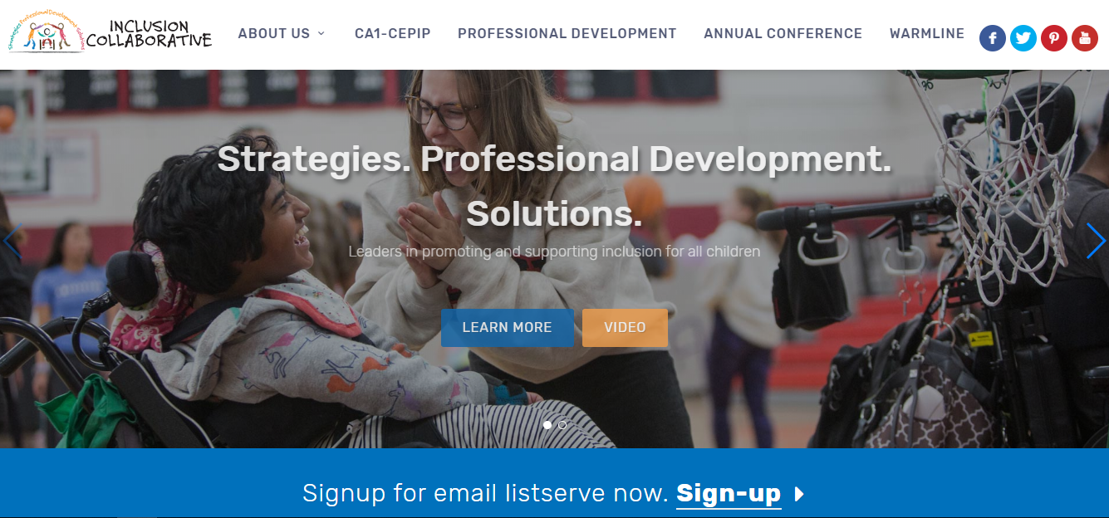
www.inclusioncollaborative.org
Notes:
Yolanda

Slide 7
Warmline Support: Parents, Teachers, Community Members can call or email
for support (English, Spanish, Vietnamese, Mandarin)

Slide 8
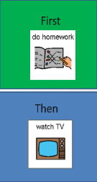
Why Visual Supports? Building a visual support toolkit can provide strategies to help children:
Understand their environment
Communicate their emotion and needs
Engage in activities
Notes:
These strategies may help a child understand your expectations and allow him to communicate his needs to you.
Teachers are critical in developing visual supports, as you can create a “tool kit” of resources to try out, then let parents know what works
Parents are critical in using visual supports, helping their child generalize what’s learned in the classroom to real life, and letting teachers know what works (especially moving between grades or schools)

Slide 9
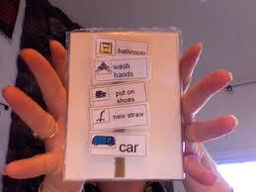
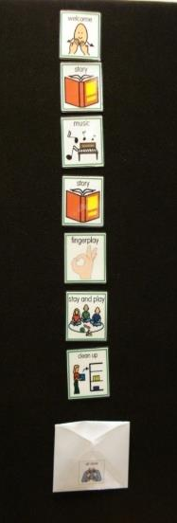
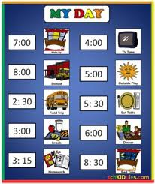
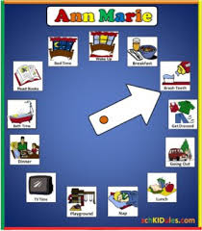
Visual Schedules
Notes:
Purpose:
To support and help children with the many transitions involved in the classroom sequence
Benefits:
Allows children to independently follow the classroom sequence
Allows children to predict what is happening next
Decreases undesirable behaviors during transitions

Slide 10
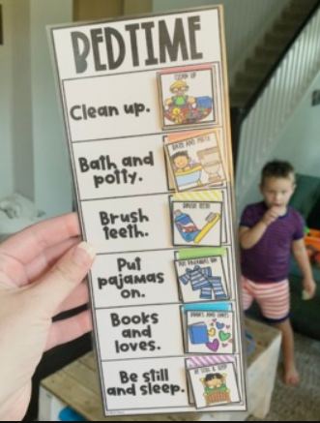
Research Facts
The use of visual schedules demonstrated a decrease in:
Anxiety
Tantrums
Acting out
Misunderstanding
Dependence on verbal prompts
Mesibov, G, Shea, V, & Schopler, E. Editors (2005) The TEACCH Approach to Autism Spectrum Disorders. New York, New York: Plenum Press.

Slide 11
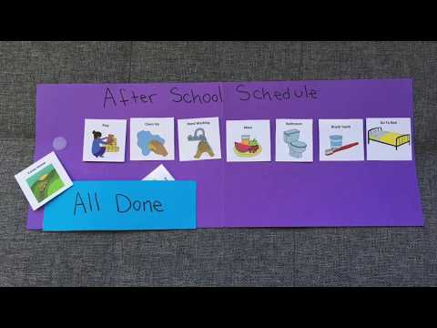
Individual Visual Schedule at Home
What was important?
Schedule good for struggles
Build in motivators
Favorite activity (outside)
Use a new placemat
Add a surprise for changes
Notes:
What was important?

Slide 12
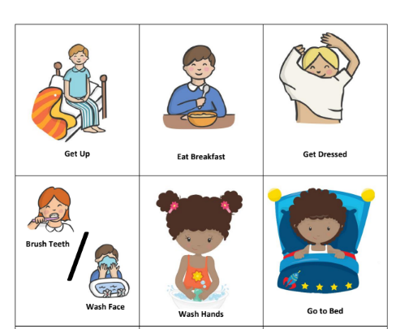
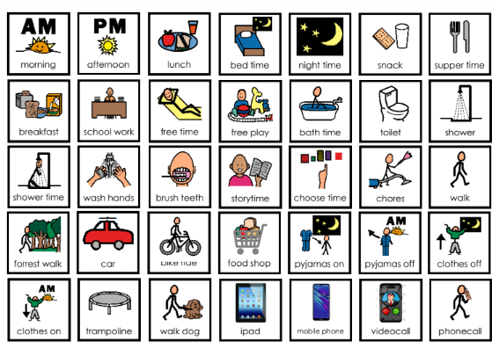
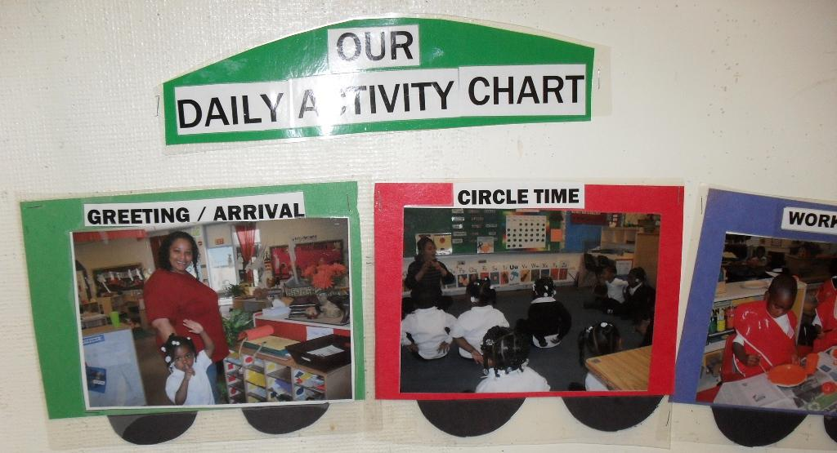
Visual Schedule Pictures
Use pictures of the child following the routine
Cartoon pictures
Boardmaker

Slide 13
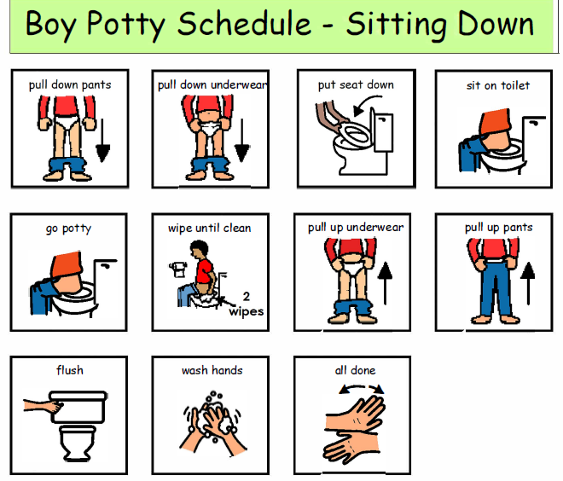
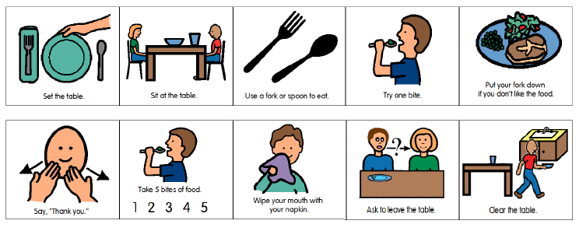
Visual Schedule: Daily
Divide into different sections of the day
Morning
Afternoon
Evening
Mini Schedules for challenges
Potty training
Brushing teeth
Taking a bath/shower
Washing hands
Eating dinner

Slide 14
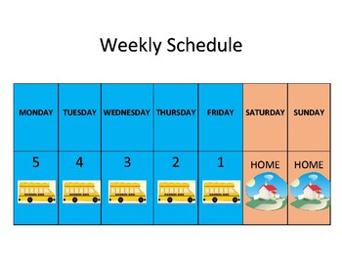
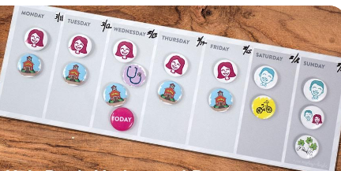
Visual Schedule: Weekly
Divorce Schedule

Slide 15
Visual Schedule in Use

Slide 16
Visual Schedule Apps
https://getgoally.com/goally-therapy-suite/visual-schedule-app/
https://apps.apple.com/us/app/visual-schedule-planner/id488646282
https://www.modelmekids.com/community-social-skills-autism.html
http://touchautism.com/app/social-stories-creator-library/
https://connectability.ca/visuals-engine/
https://apps.apple.com/us/app/visual-schedule-social-story/id1441633751

Slide 17
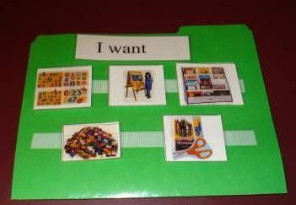
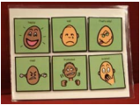
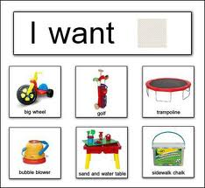
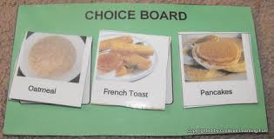
Choice Boards
Notes:
Purpose:
To allow a child to make choices, express wants and feelings
Benefits:
Gives child control over their environment
Can help you learn the child’s preferences

Slide 18
Benefits of Choice Boards
Builds communication
Decreases tantrums
Adds variety
Encourages independence

Slide 19
Child Using a Choice Board

Slide 20
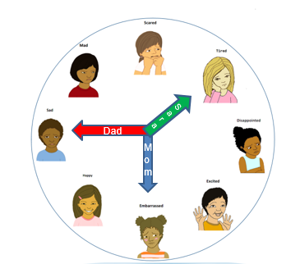
Choice Boards from the Inclusion Collaborative
Activities
Food
Toys
Songs
Emotions
Email: inclusionwarmline@sccoe.org for copies of choice boards

Slide 21
Choice Board Apps
https://apps.apple.com/us/app/choice-boards/id1059544273--this one is free
https://apps.apple.com/us/app/choiceboard-creator/id453988580--you can create your own choiceboard
https://apps.apple.com/au/app/so-much-2-say-picture-communication/id452389274?ign-mpt=uo%3D4--expensive more also extensive

Slide 22
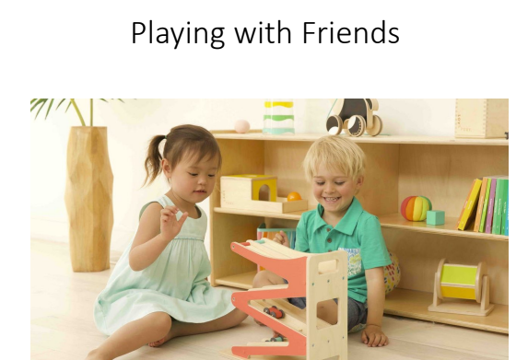
Visuals: Social Stories
Social Stories explain
routines with which a student is having difficulty or is unfamiliar
expectations
social behaviors that are acceptable
replacement behavior options
Email: inclusionwarmlin@sccoe.org for Social Stories
Notes:
When a student fails to grasp social norms, routines, and expectations, like walking down the hall, using restroom facilities, following lunch procedure, using manners, using greetings, asking for help properly, etc
When a student is on the autism spectrum or has ADD/ADHD
When a student is disorganized, unprepared, disheveled
When a student needs reinforcement of class rules, routines, procedures, etc
When a student lacks social skills
When a student does not respond to cues, redirection, refocusing, etc
When a student fails to complete work, homework, expectations, etc

Slide 23
Purpose of Social Story
Help the person
understand a situation and expectations
feel comfortable with the situation and expectations
understand how to fit in

Slide 24
A Mom’s Perspective

Slide 25
Social Stories
Told from the child’s perspective
Explains the routine and expected behavior
Lots of pictures

Slide 26
Format of a Social Story
Written in present tense
Structure
Beginning—
identifies the situation
what others and I do
how others and I feel
Middle—
what is the expected behavior
why others and I follow the expected behavior
how others and I feel
End—
How others and I feel when we follow the expected behavior
Notes:
General format. You can follow or be a little loose. Researchers have found that following Gray’s specific directives doesn’t really make the story more effective.

Slide 27
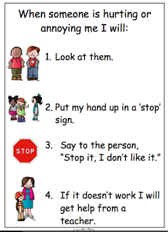
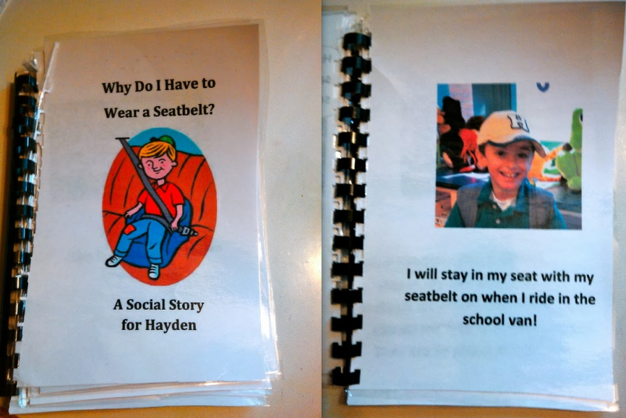
How to Format the Story
Multiple Pages
Advantages
Disadvantages
Single Page
Advantages
Disadvantages

Slide 28
How to Interest Kids in a Social Story
If possible, figure out the reason for a behavior
Avoid the activity/ person
Unfamiliar with the routine/ activity/person
Wants attention/something else
Overwhelmed
Soothing
Make sure the story is accurate
Use language the child understands
Use pictures that interest the child
Notes:
Discuss why it is helpful to figure out the reasons for behavior before you write a social story

Slide 29
Involve the Child in Writing a Social Story

Slide 30
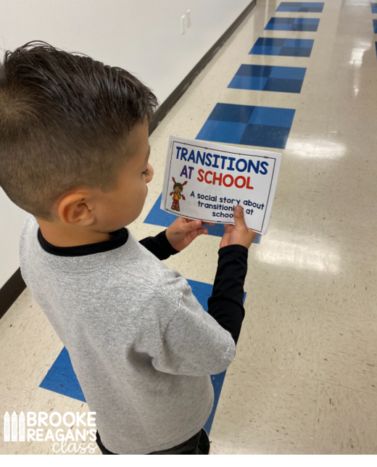
When to Introduce the Social Story
Consider when and where to introduce the story
Positive place
Comfortable place
NOT directly follow a behavior
don't want child to associate social story with something negative
If it’s about a specific activity or routine, read it before the activity

Slide 31
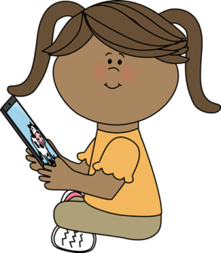
Types of Pictures
Personal
Real kids--Find on the internet by searching for the topic
Drawings/Clipart (free kid clipart)
http://www.phillipmartin.info/clipart/homepage.htm
http://www.mycutegraphics.com/
Icons
Boardmaker https://goboardmaker.com/
Search “icons social stories” or “boardmaker icons”
Notes:
What are the advantages and challenges of these

Slide 32
How to Create
Use PowerPoint, Google Slides, Word, or any program you’re comfortable with
Copy picture
Crop or change as needed
Use Paint to erase parts you don’t need and draw in those you do
Add lines, circles, arrows, speech bubbles
Write the words
Feel free to draw by hand
Notes:
Show on the computer

Slide 33
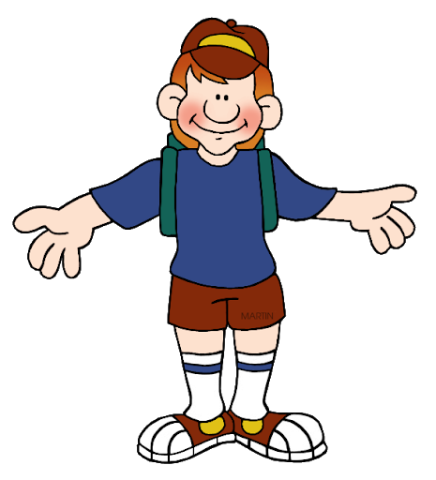
Advanced: Editing Clipart in Powerpoint
Grab picture
copy
snip
paste
Go to picture tools:
Wrap text: in front/behind
Color: Set Transparent

Slide 34
Advance Practice: Editing Pictures with Paint

Slide 35
Use Video!

Slide 36
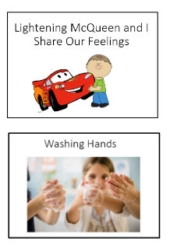
Social Stories from the Warmline
English
Spanish
Email the Warmline at: inclusionwarmline@sccoe.org or
Email:
slarkin@sccoe.org

Slide 37
Review
Visual strategies to Support Children
Schedules
Choice Boards
Social Stories

